Slide 1
Journey
Map
Deepthi Peter
Associate Data Engineer

Slide 2
Azure Synapse Analytics (19/09/2023)
Key Learnings:
What is an Azure Synapse Analytics?
It is an enterprise analytics service that accelerates time to insight across data warehouses and big data systems
It brings together the best of SQL technologies used in enterprise data warehousing, Spark technologies used for big data, Data Explorer for log and time series analytics, Pipelines for data integration and ETL/ELT, and deep integration with other Azure services such as Power BI, CosmosDB, and AzureML
Synapse SQL - a distributed query system for T-SQL that enables data warehousing and data virtualization scenarios.

Slide 3
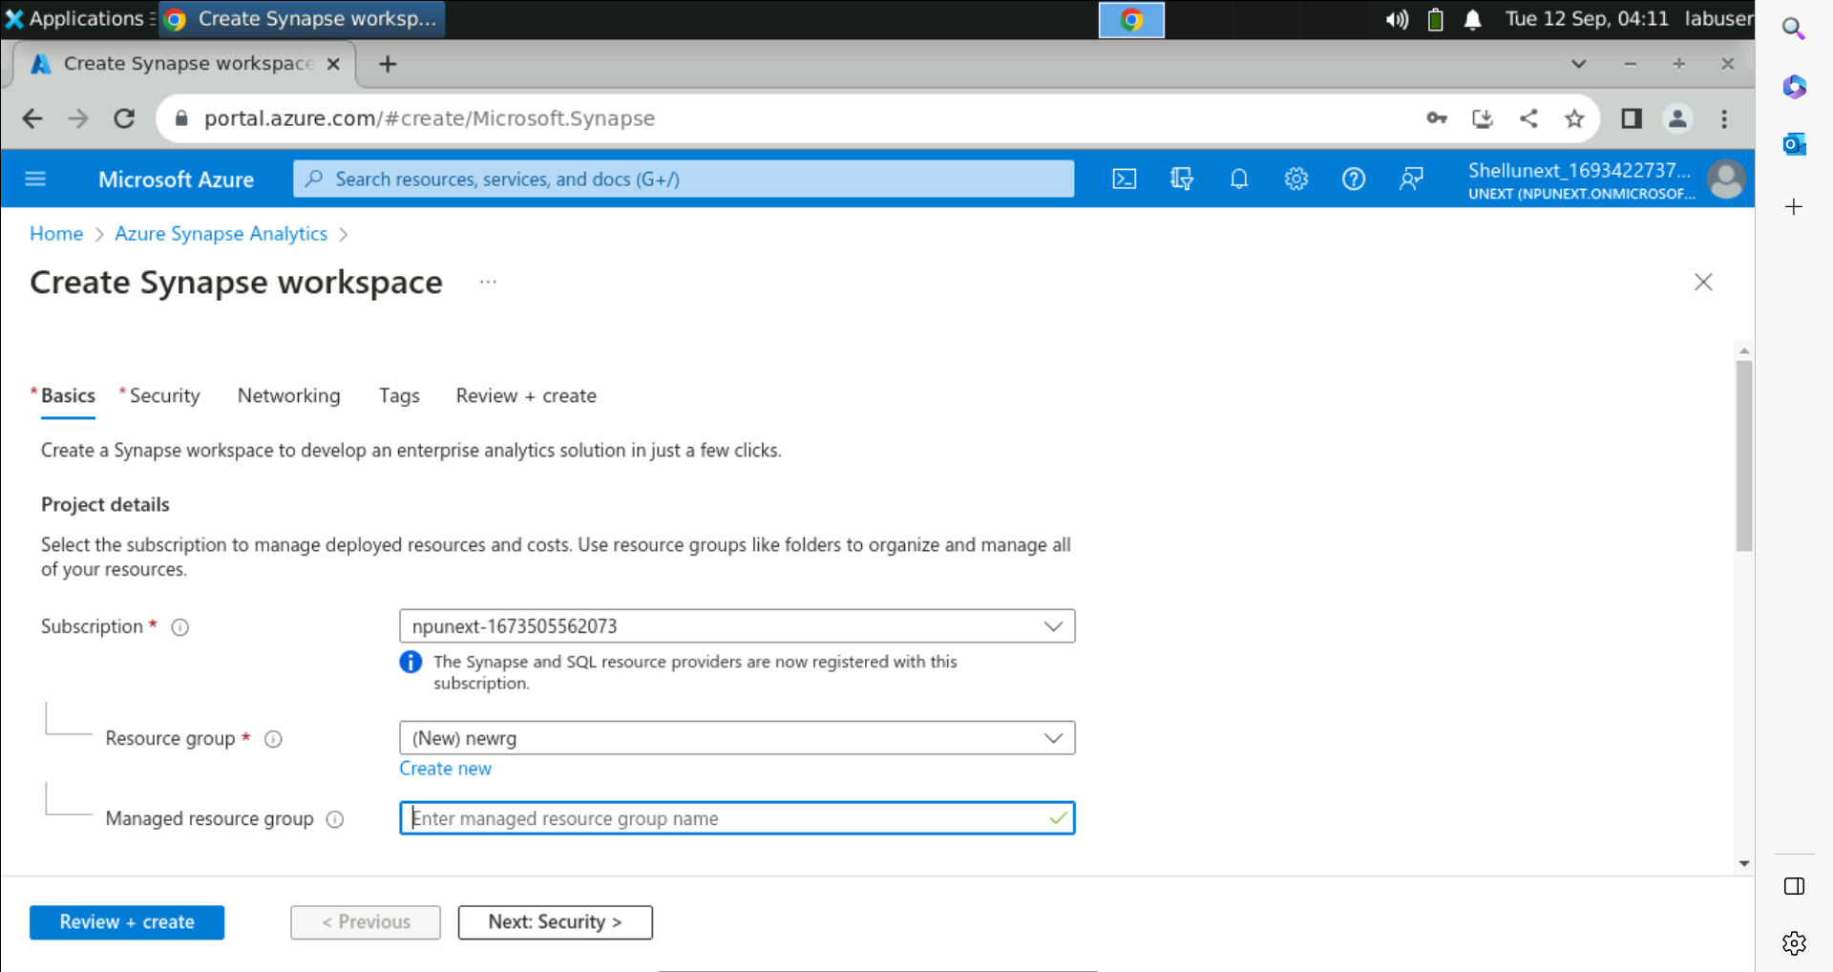
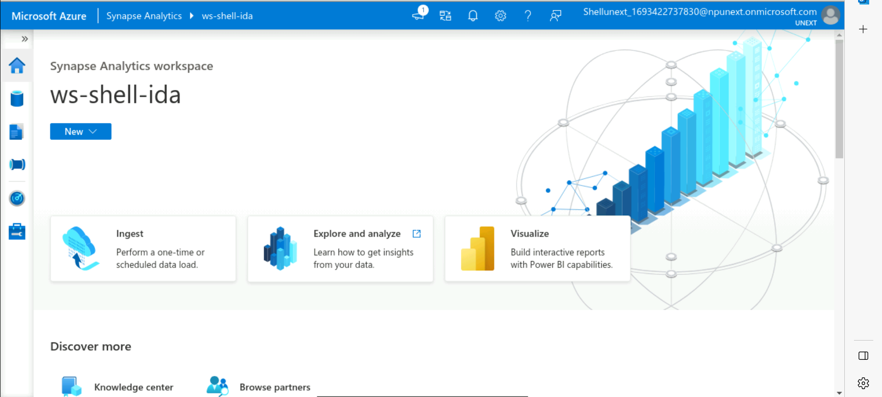
Create an Azure Synapse Workspace

Slide 4
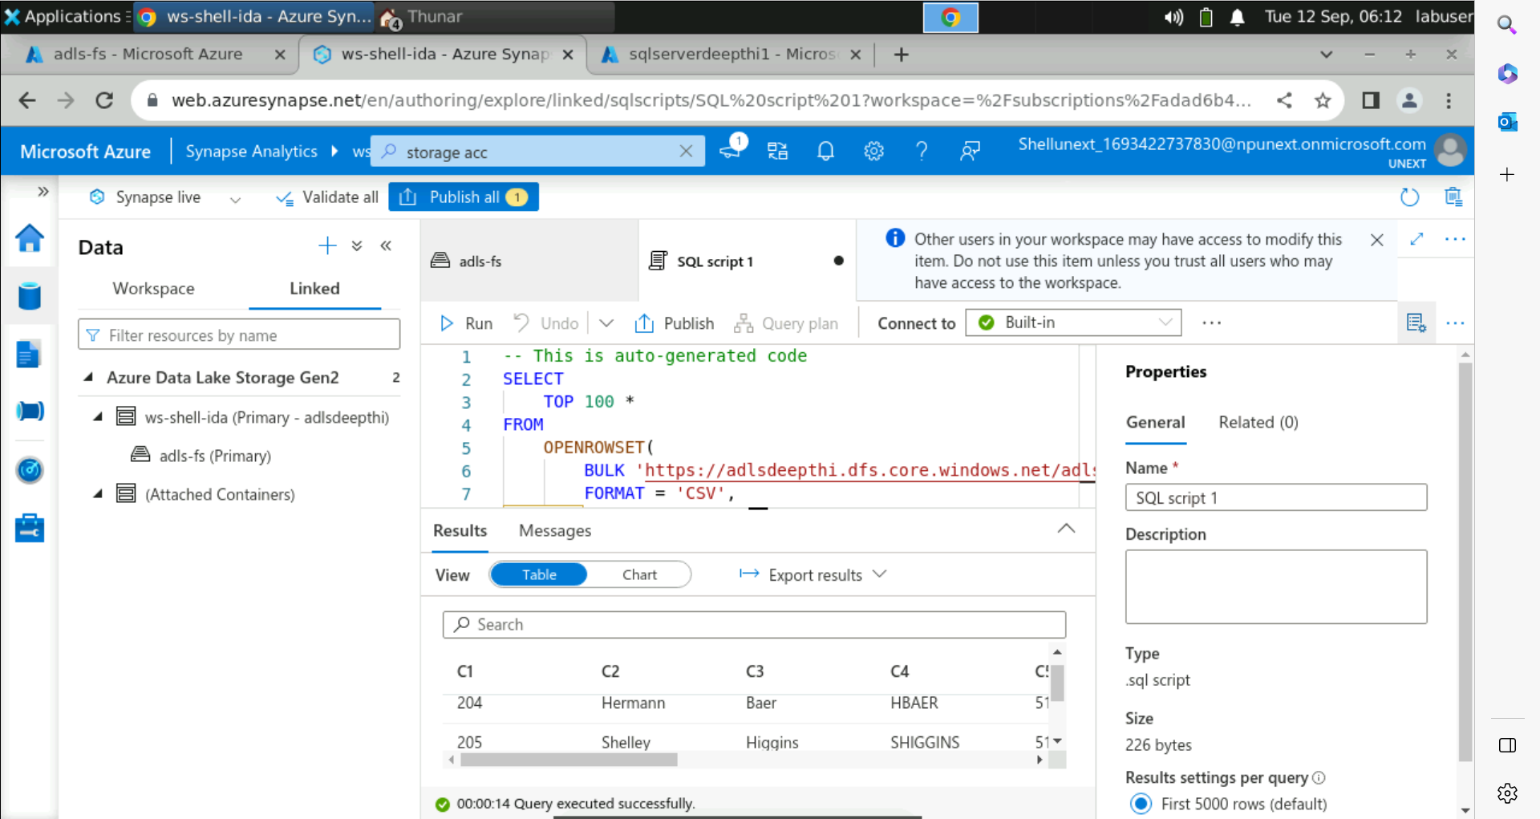
Azure Synapse SQL

Slide 5
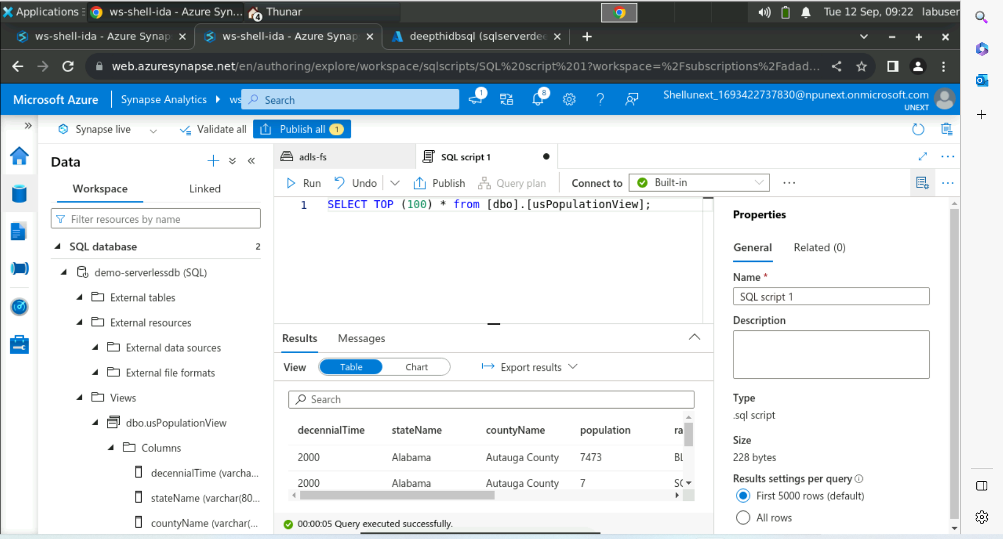
Views in Synapse

Slide 6
Power BI (13/09/2023)
Key Learnings:
Introduction to Power BI
Power BI is a collection of software services, apps, and connectors that work together to turn sources of data into coherent and interactive insights.
Flow of work in Power BI
Begins by connecting to data sources in Power BI Desktop and building a report, which can then be published from Power BI Desktop to the Power BI service
DAX in Power BI
It is a collection of functions, operators, and constants that can be used in a formula, or expression, to calculate and return one or more values.

Slide 7
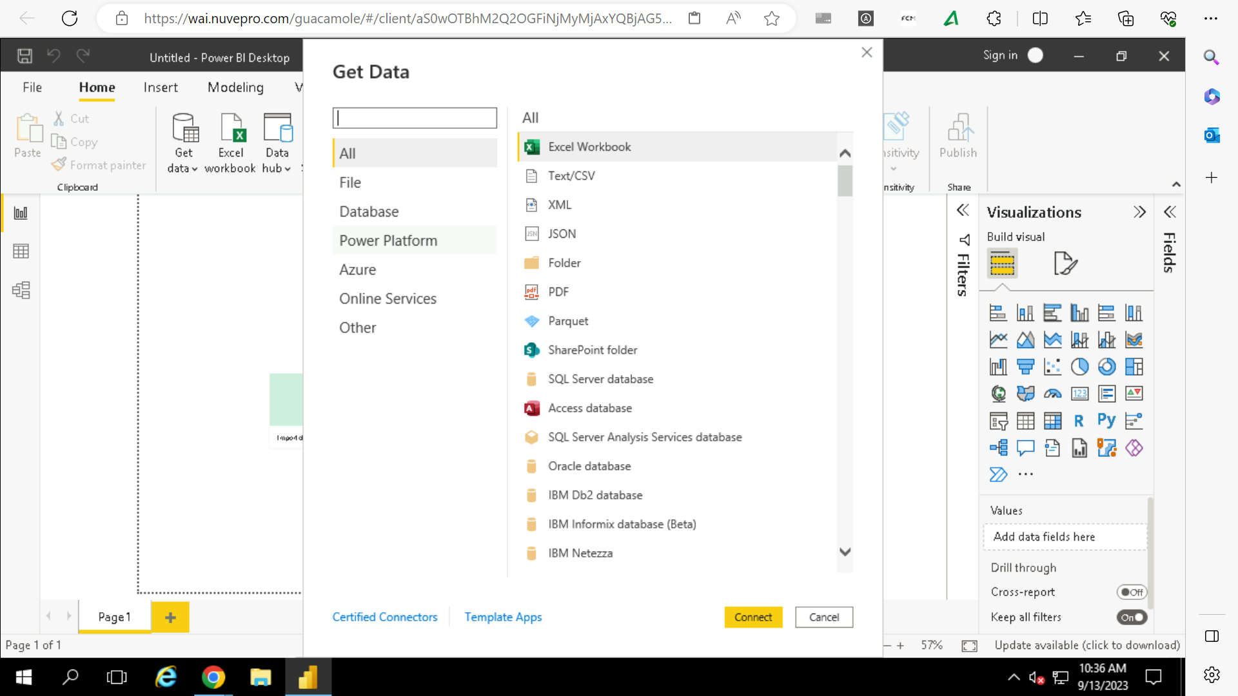
Starting up Power BI

Slide 8
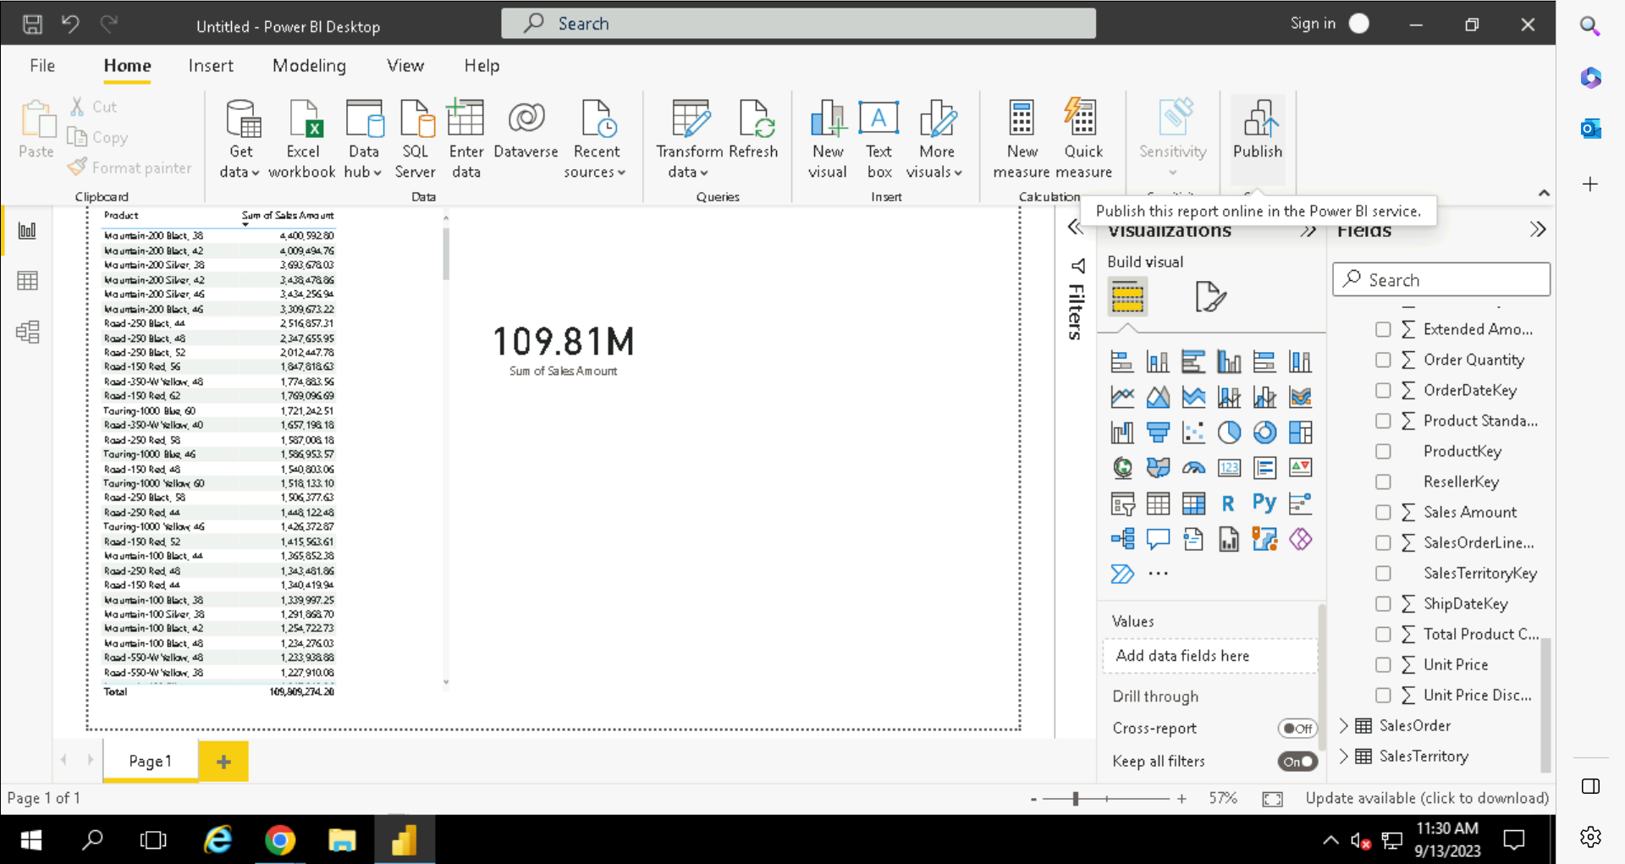
Create reports in Power BI

Slide 9
Power BI (14/09/2023)
Key Learnings:
Loading datasets from SQL server to Power BI
Managing relationships among entities in Power BI
Data Hierarchy
Drill Up and Drill Down in Power BI
Change the visual’s view to one level below or above in the data hierarchy
Create roles to manage visualizations of data

Slide 10
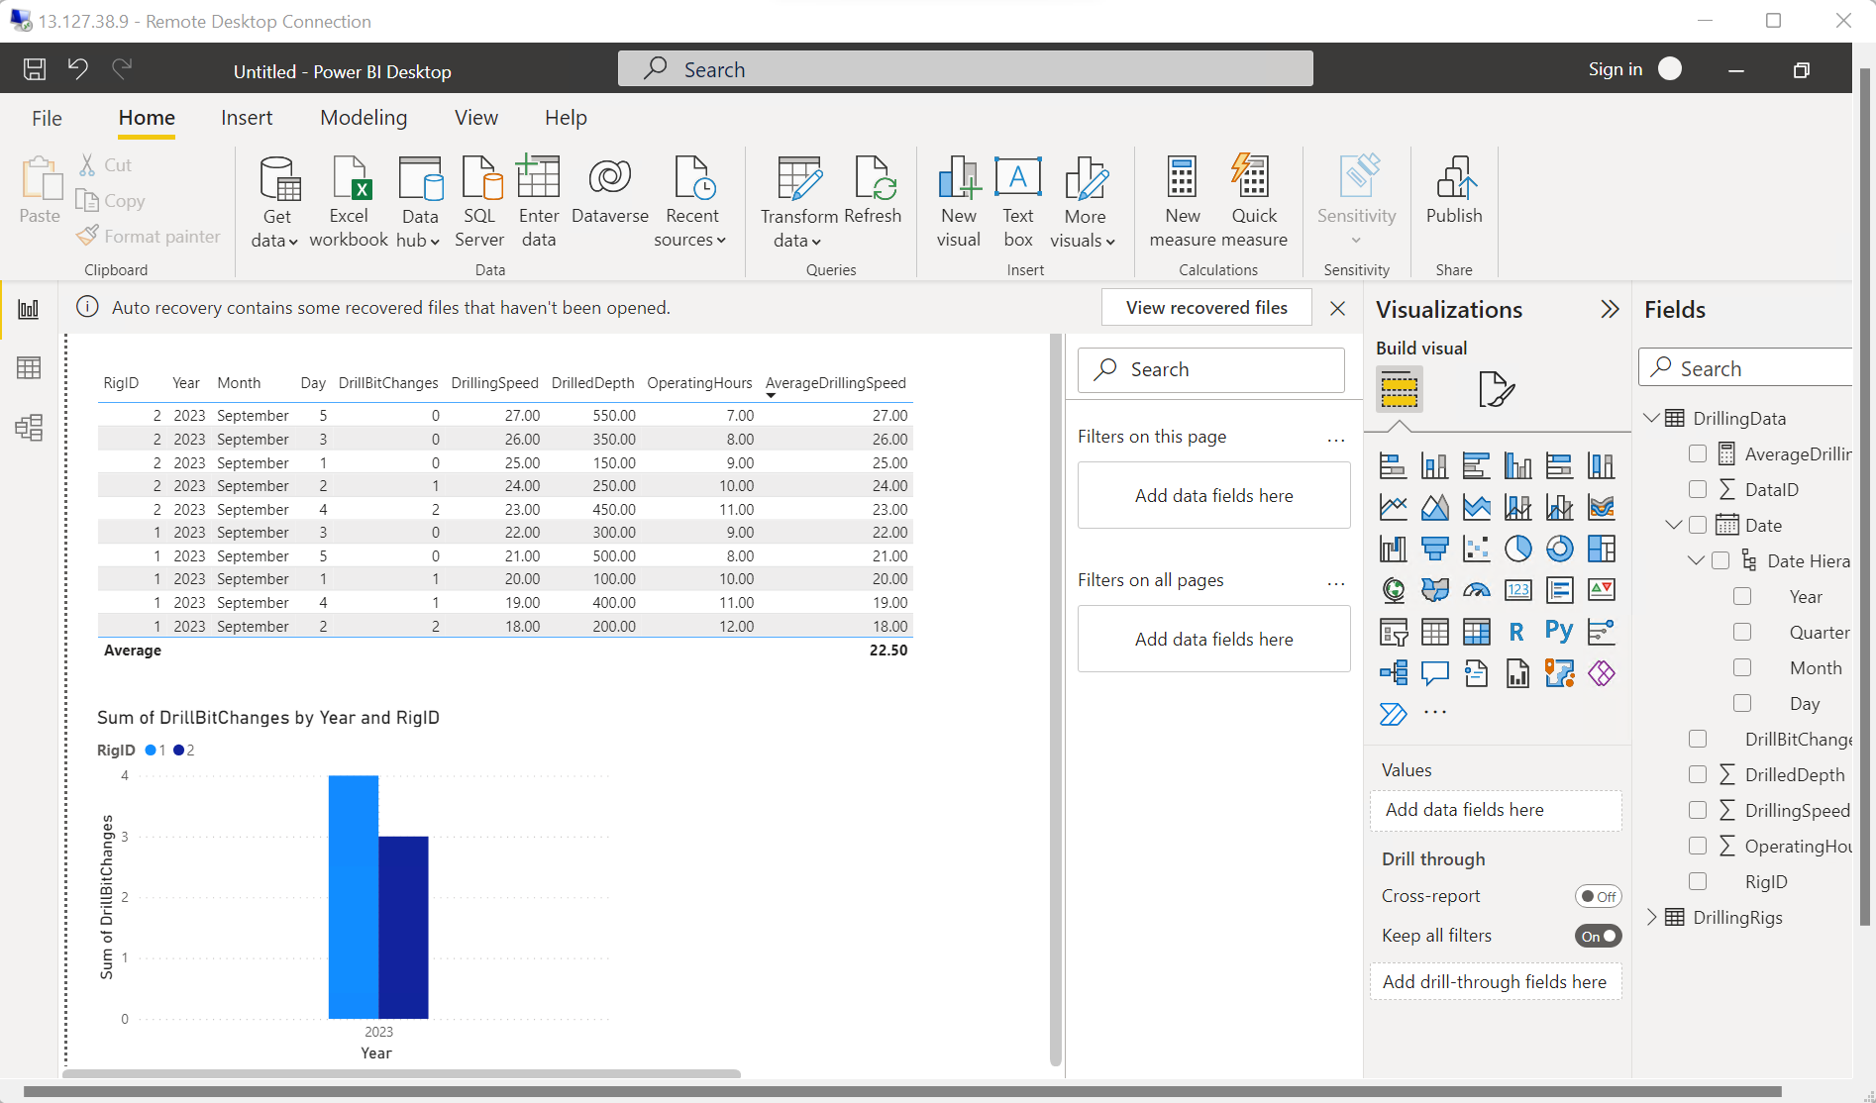
Create Reports on data from SQL server

Slide 11
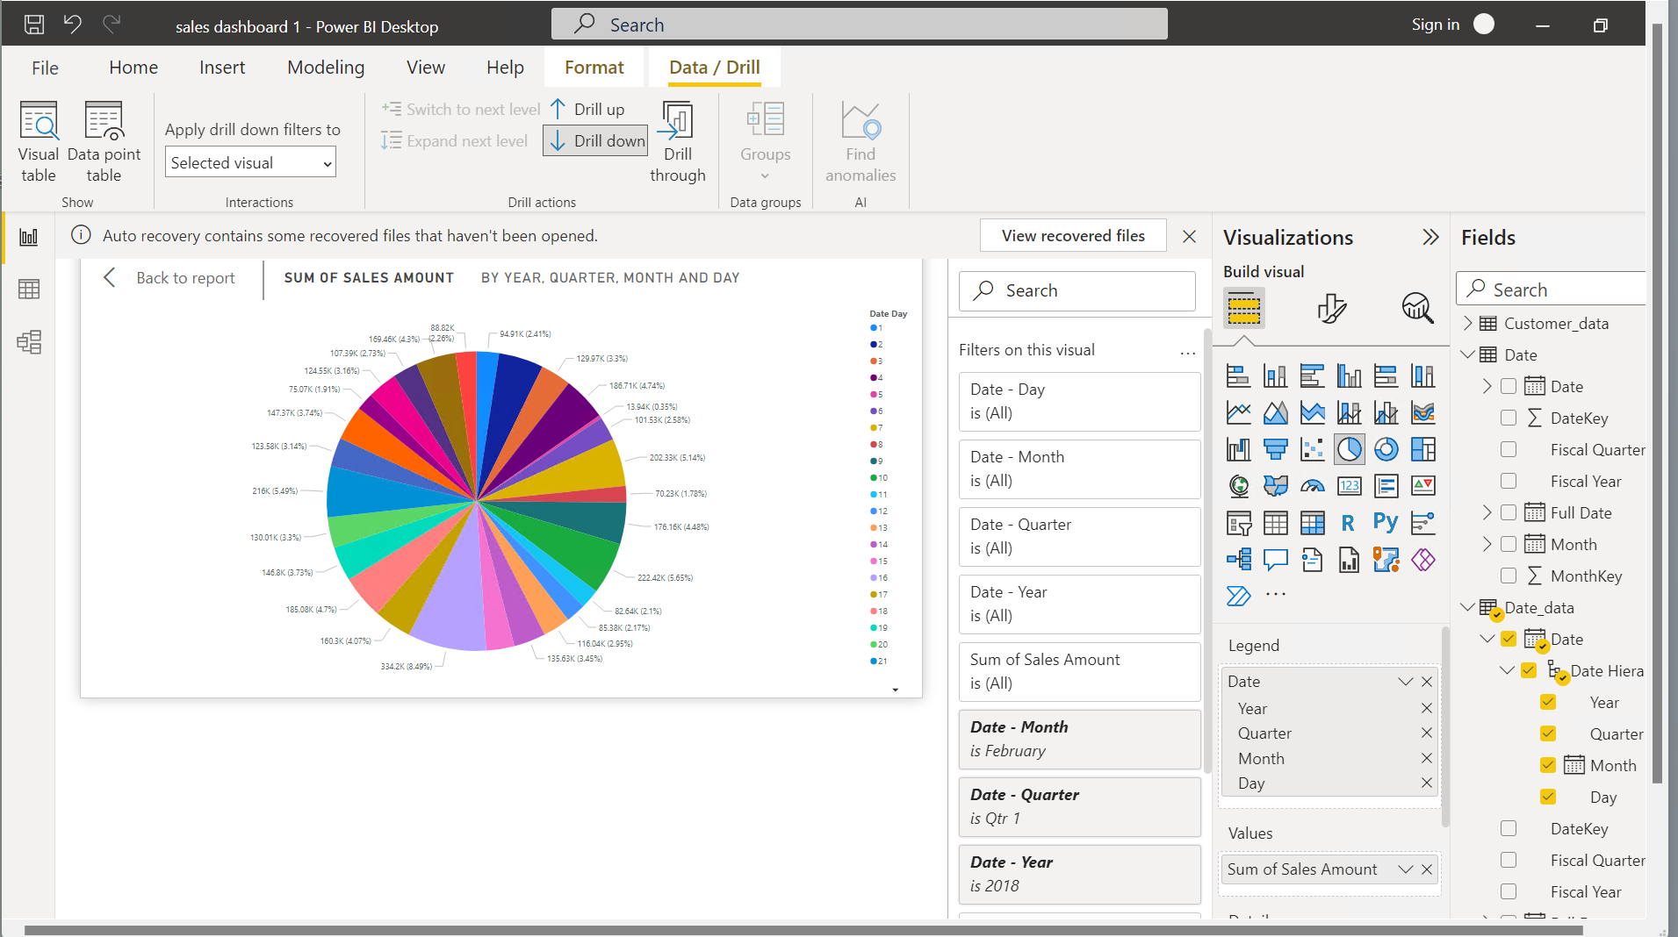
Drill Down operation

Slide 12
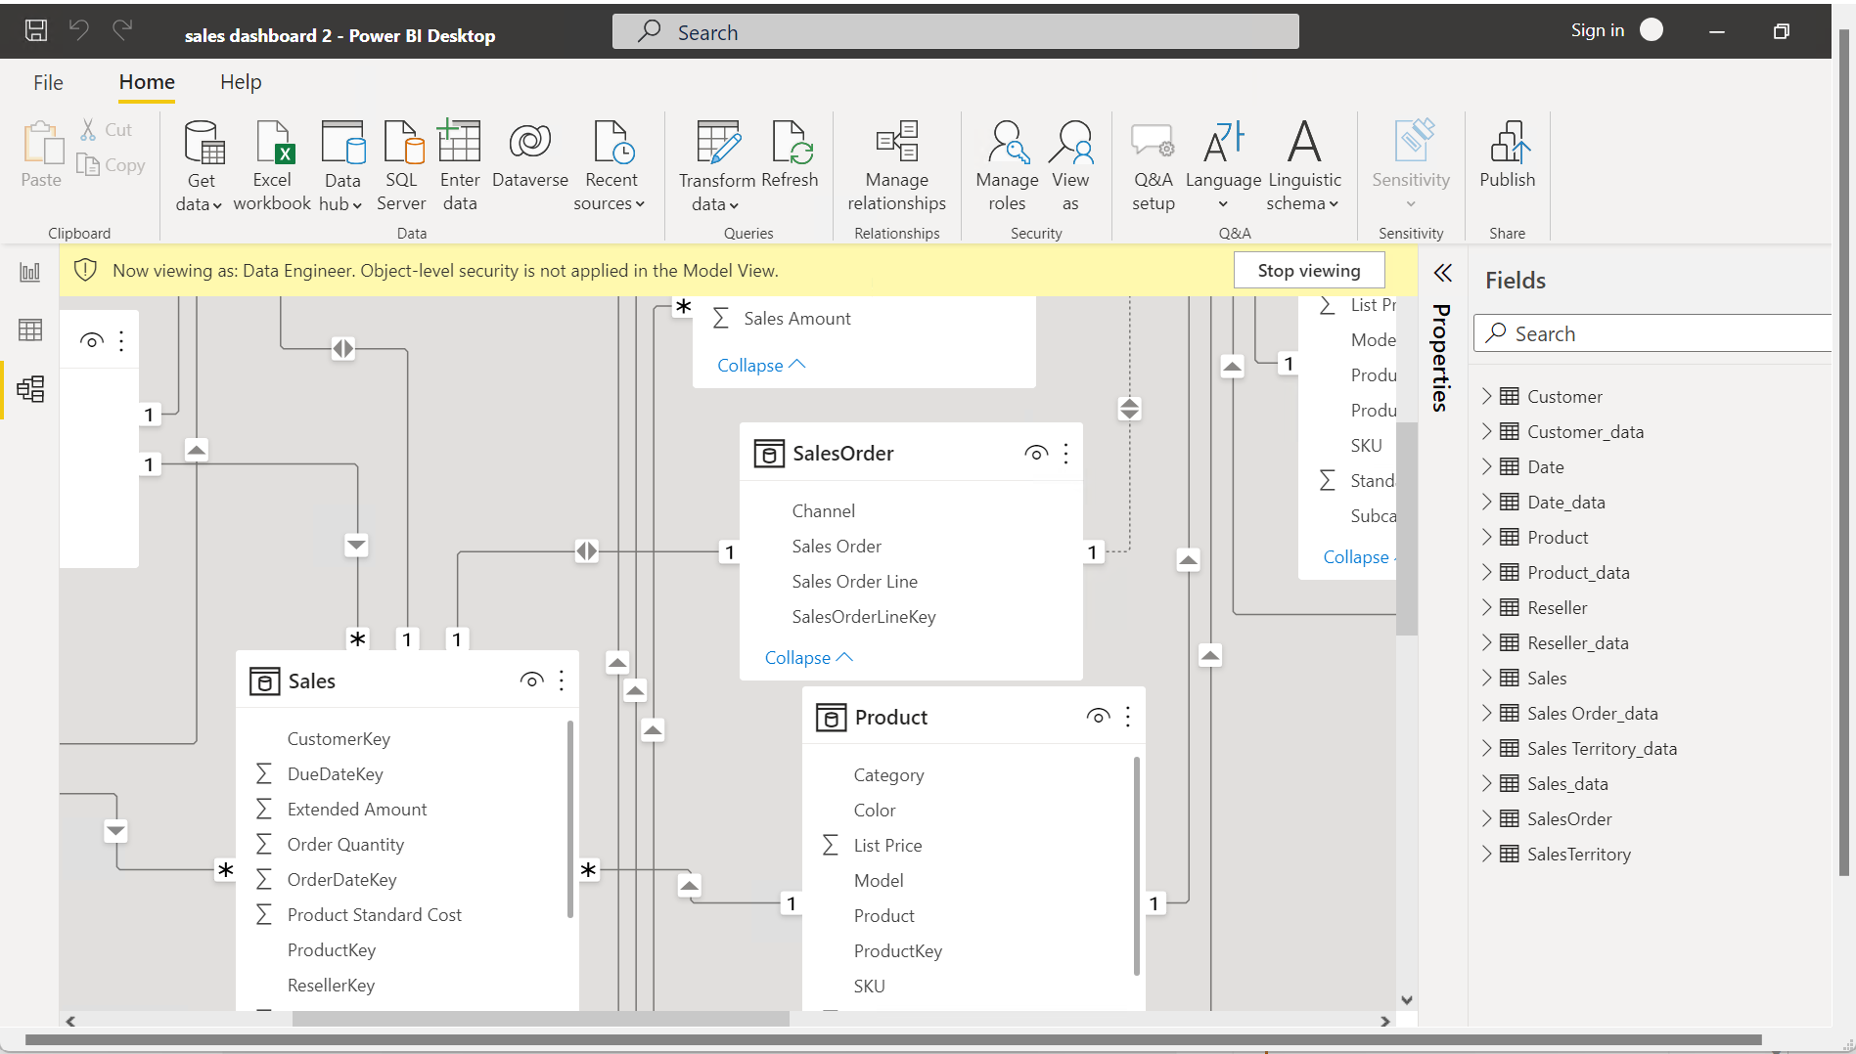
Roles in Power BI

Slide 13
Python (15/09/2023)
Key Learnings:
Features of Python
Dynamically typed
Datatypes in Python
Memory management in Python
General purpose language
Type Inference

Slide 14
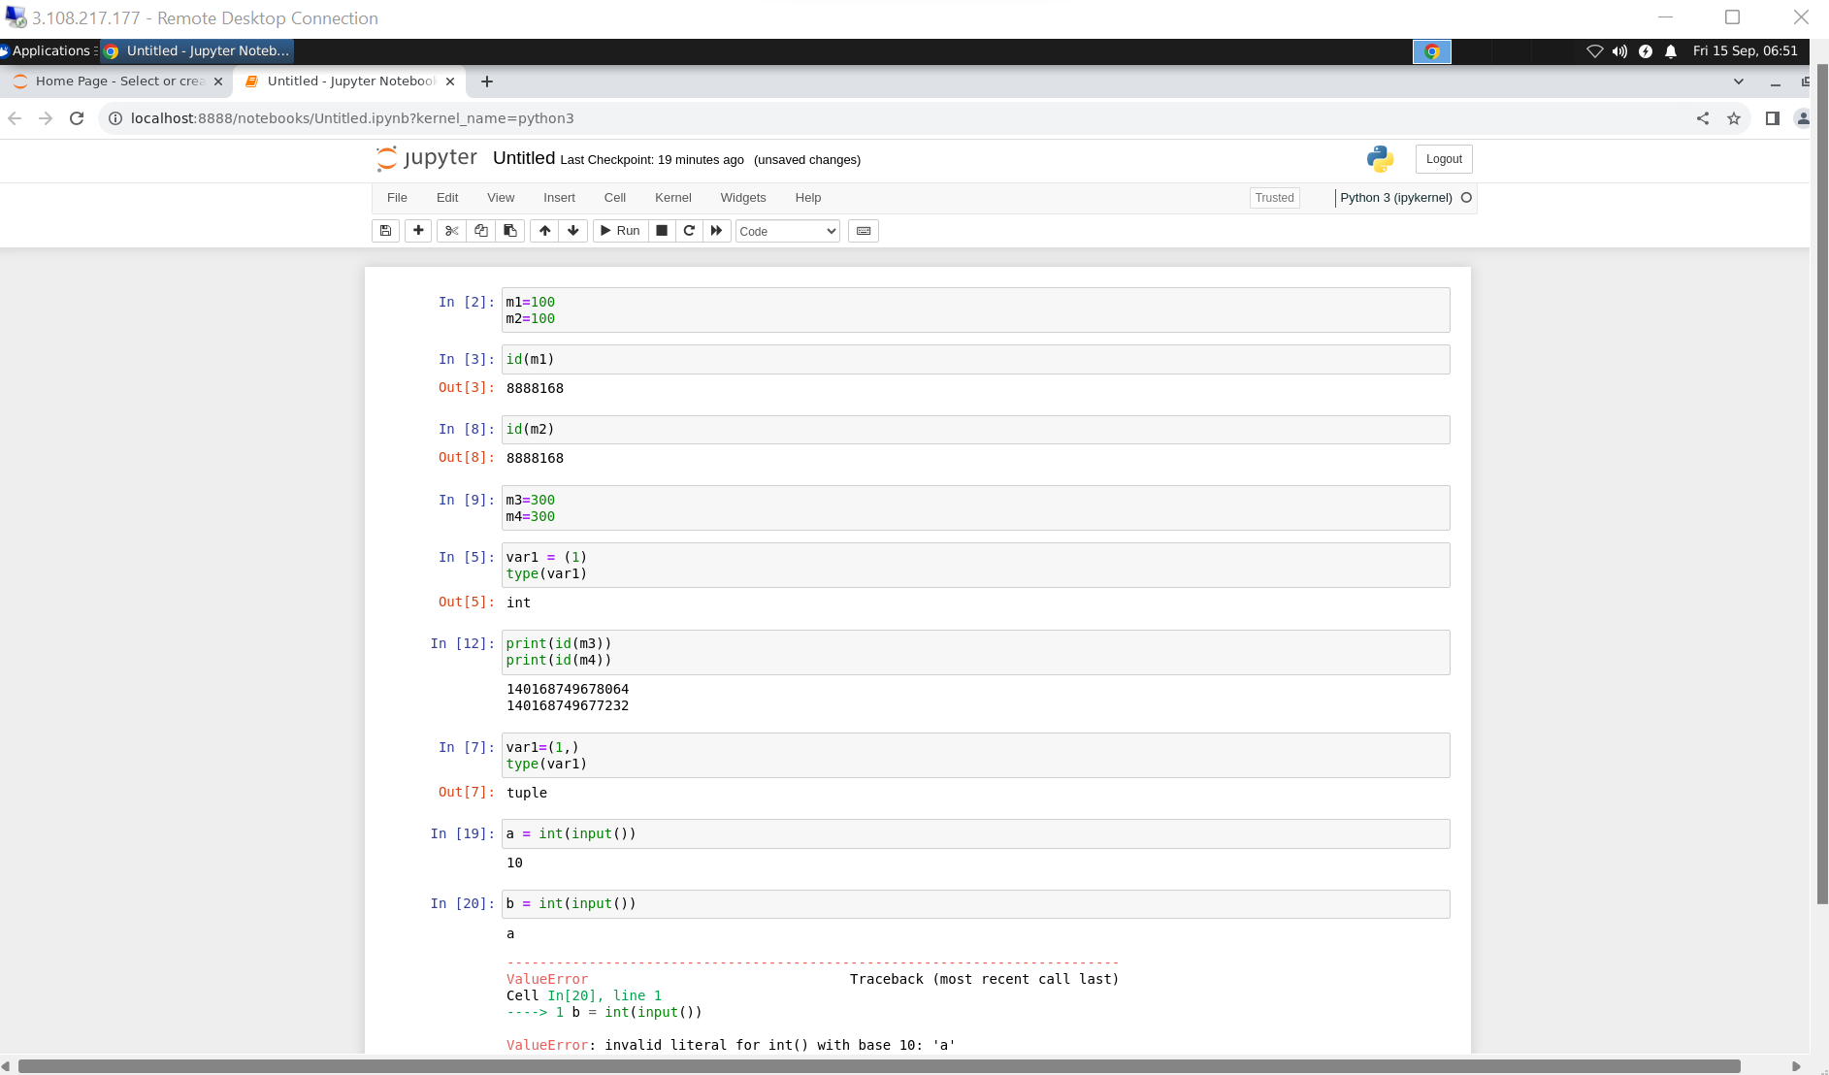

Slide 15
Thank You

